Slide 1

FOOD SAVR
Pioneer Weekend 2021
Michael Andrzejewski, Shrey Agrawal, Hwi Jin Jang, Nameera Dawood, and James Lim

Slide 2
160,000,000,000
40% of Food is Wasted in the US, amounting to a loss of approx $160 billion per year
https://www.highereddive.com/news/college-combat-food-waste/510987/

Slide 3
22,000,000
22,000,000 lbs of food is wasted on college campuses and 142 lbs of food wasted by average college student.
https://www.highereddive.com/news/college-combat-food-waste/510987/

Slide 4
1 in 5
20% of college students reportedly have low food security.
https://www.highereddive.com/news/college-combat-food-waste/510987/

Slide 5
“It’s not my problem.”
Two in five Americans know someone who has experienced hunger in the past year, but continue to believe firmly that dealing with hunger is government’s responsibility.
Americans’ desire for government to address the issue outstrips the personal responsibility they feel to do so.
One in four adults says they have “not much” or no responsibility to reduce hunger.
https://frac.org/wp-content/uploads/frac_tyson_oct_2014_public_view_hunger_poll.pdf

Slide 6
“Do you waste food?”
Do we have a food waste problem in Dining hall right now? Are there meals that go unused? On average people waste 6 paid meals per week.
“At least 2, I don’t each lunch and breakfast on weekends. Out of 15 I miss 5-7 meals”
“On Monday, Wednesday, Friday I waste lunch meals.”
“I waste at least 4 or 5 meals”
“2-3 meals/week”
“Too many to count.”
“They don’t keep track of expiration, so they just waste that food because it was ordered and was not used.”
“When I worked a shift I would get a free meal so I would waste those meals.”
“enough to feel bad about wasting food”
“I saw someone throw away a huge barrel of milk.”
“A lot of the times a tray is switched out before it is actually empty. Workers will switch out and throw away a tray of food when they ‘feel’ it is getting empty, not when it is actually empty.”
“7 meals per week”
“
“3-6 meals/week”
“While working in dining my first semester, I threw away A LOT of leftover food myself.”
“On average I probably waste 5 meals”
“Like around 7 meals a week”
*All quotes are collected from a representative stratified sample of students
Notes:
Do you waste food? Was one of our questions in the interviews and as you can see, there are overwhelming amounts of answers that state they missed several meals and on average, people wasted 6 paid meals per week.

Slide 7
Every single day, hundreds and hundreds of people in our community go hungry.
Notes:
Every single day, hundreds and hundreds of people in our Grinnell community go hungry.
(pause)
You know, there is a reason I’m passionate about this project. As a kid, my dad was never had enough food to eat. Today, I’m several inches taller than him, and he likes to joke that if he’d had more food as a kid, I wouldn’t have grown so much taller. But it’s not a joke. Food insecurity… deeply hurts people and their families.

Slide 8
For us this is unacceptable.
We should not and WILL NOT stand for this.
Notes:
(potentially) Michael

Slide 9
We believe in taking responsibility for food insecurity in our community.
We will mobilize Grinnell at large and put a stop to careless food waste.
We believe in creating a community that can feel food safe.

Slide 10
What can we do to reduce food waste and combat food insecurity?
Food Savr
uniting to fight hunger
Notes:
Shrey

Slide 11
Our solution
Engaging mobile application for students to access and manage Dining hall meals, including allowing them to donate meals they plan to miss.

Slide 12
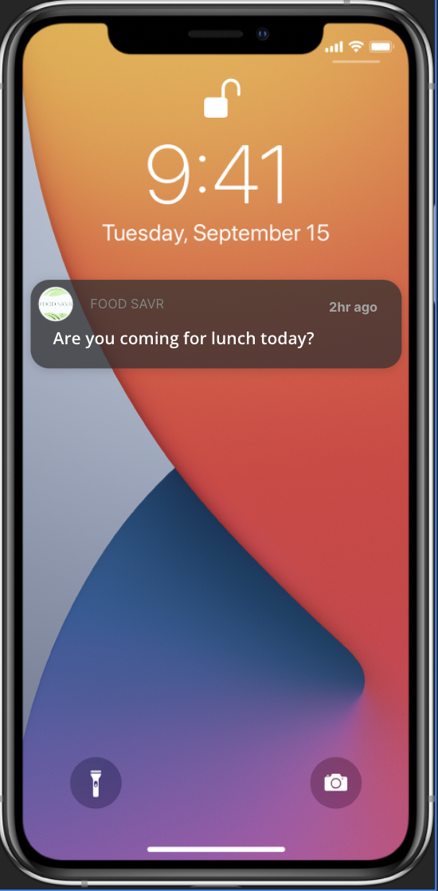
Meal push notification
Asking user if they are coming for the meal

Slide 13
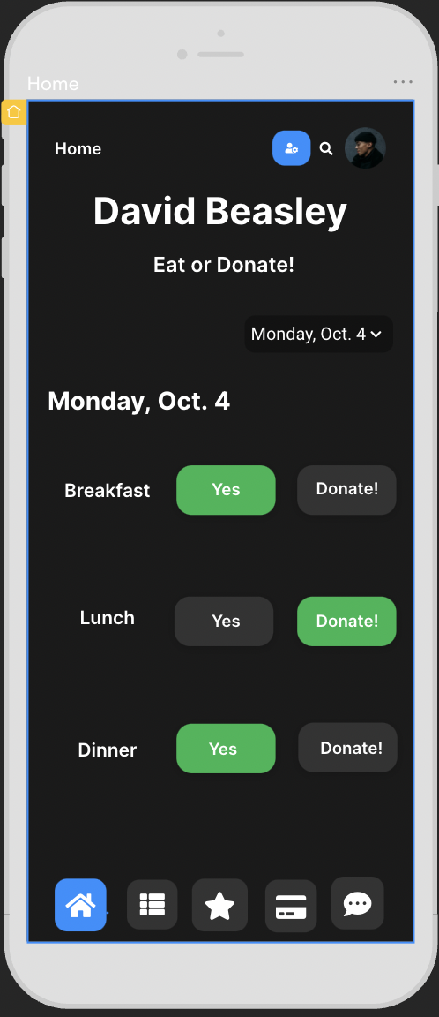
Home Screen
The user can choose to come for the meal, or choose to donate their meal to LFC, FRN, CRSSJ
Timeline of reporting: Advance, before cooking, after cooking.
Giving dining hall workers a more accurate number of meals to cook to reduce overproduction

Slide 14
What else does our app offer?
Notes:
Hwi Jin

Slide 15
“What is Net Nutrition?”
The most common answer we got when we asked people what they thought about Net Nutrition, was “What is Net Nutrition?”
“It is not the most user friendly or reliable..”
“I don’t know what Net Nutrition is”
“I never use nutrition. But it seems like a good idea to try and help people eat healthy/see what foods fit their diets”
“only use it once in a while...”
“I barely use it because it’s not accurate!”
“ it's interface is hard to navigate and outdated”
“What is net nutrition?”
“I haven’t really used Net Nutrition. Didn’t really know about it till recently. Think it could use more work in getting people to know about it”
“It’s been down for three days!”
“Net Nutrition is so bad!”
“Net Nutrition is crucial to students on a lower meal plan because we want to choose the right times to go to dhall so our meals aren’t wasted!!!”
“literally no one has time to use it because we are all just trying to eat hahaha”
“Net nutrition like in the website?”
“I don’t even know what that is…”
*All quotes are collected from a representative stratified sample of students
Notes:
James
The college has tried to resolve this problem with an online menu. The problem is, it sucks. When we asked students what they thought about it, most of them had never even heard the name.

Slide 16
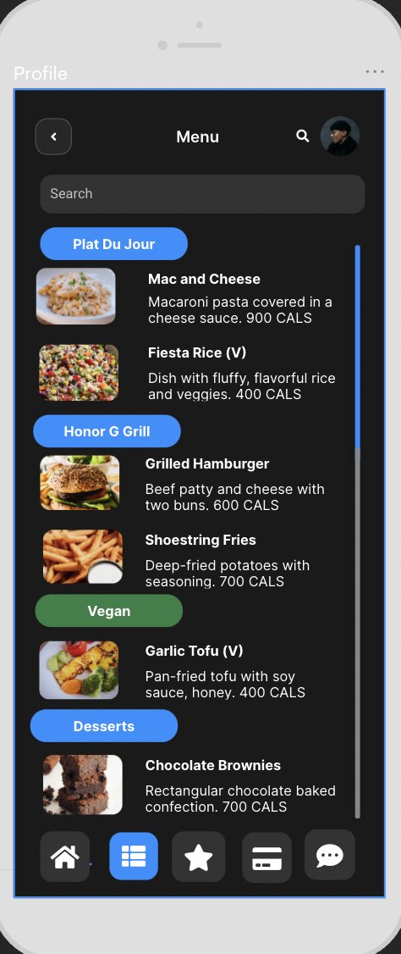
Menu
Interactive display of food that is being served
Accurate details of available menu
Dining workers can easily drag drop menu items as menu changes

Slide 17
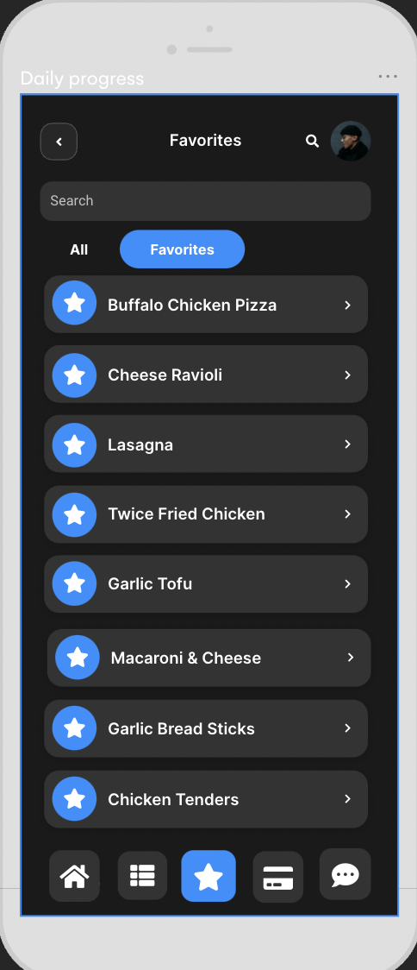
Favorites
User can select their favorite food to get notifications

Slide 18
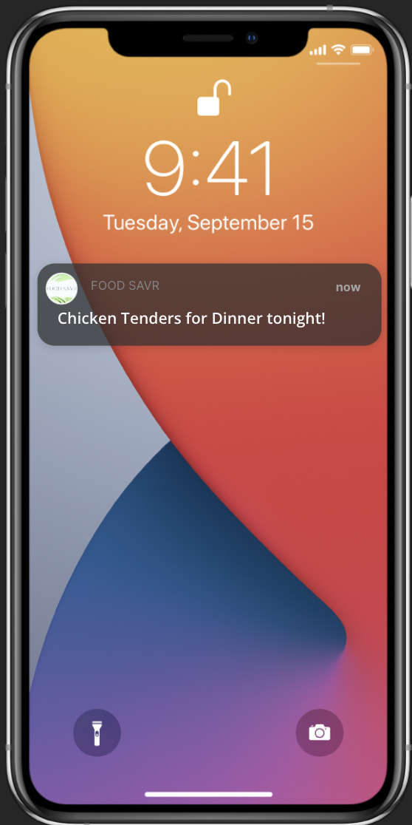
Favorite Food Notification
Notifies the user when their favorite food is being served

Slide 19
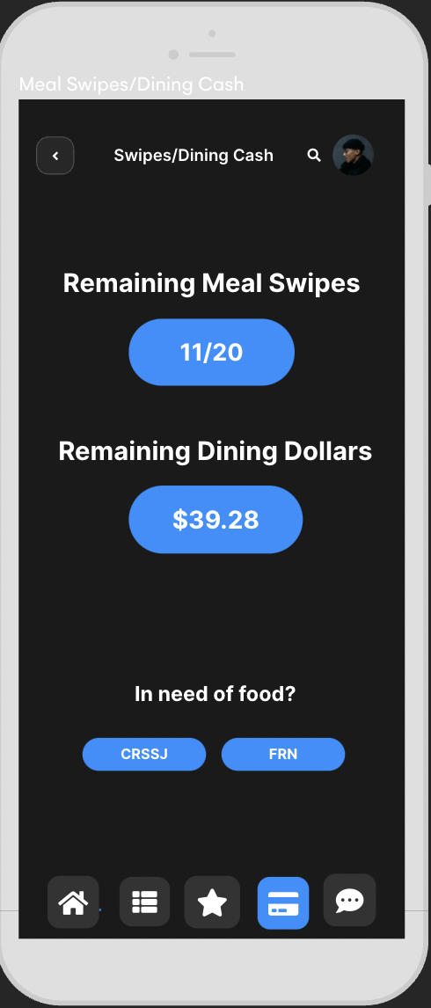
Managing swipes and dining dollars
Resources to get food

Slide 20
“We have a suggestion box?”
The most common answer we got when we asked people what they thought about the suggestion box, was “Do we have a suggestion box?”
“I have never used it because I never noticed it”
“I feel like the suggestion box isn't an active part of the dining halls decision making”
“what the heck is the suggestion box”
“ doubt it goes anywhere”
“Didn’t know there was a suggestion box at dhall.”
“There’s a suggestion box in dhall???”
“I haven’t even used one, I don’t know where it is”
“I don’t think it’s used very often if at all..”
“I have not yet been able to use the suggestion box”
“I don’t use the suggestion box either. I doubt suggestions have any effect though”
“Didn’t know there was one.”
“rarely use it”
“Never used it”
“I was not aware we had one”
“I don’t even know what that is”
“didn’t know that was a thing”
*All quotes are collected from a representative stratified sample of students
Notes:
“Did you know that Grinnell DHall has a suggestion box? Well, neither does anyone else. We want to give Grinnell students the chance to improve their meals and exert self-gov.”

Slide 21
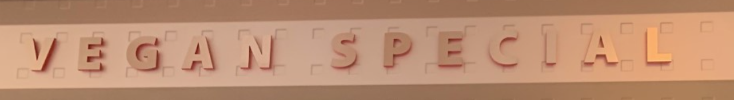
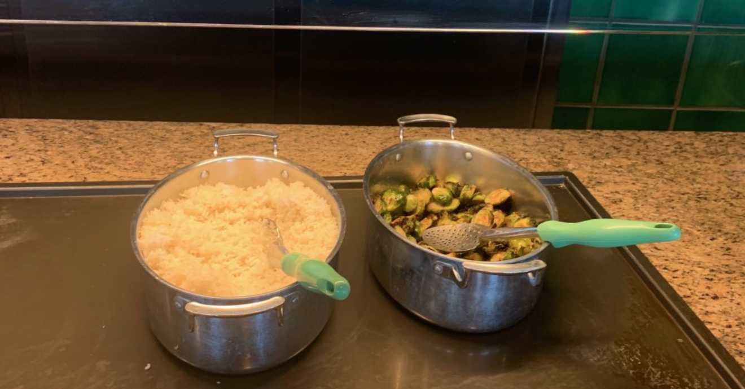
“I asked if they were going to have anything else and they were not. This was all they had as the vegan and vegetarian option.”

Slide 22
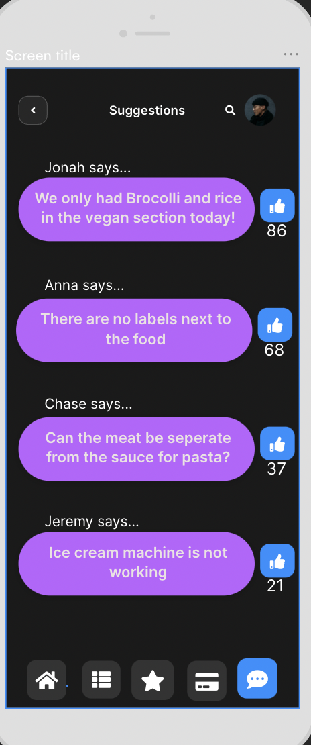
Suggestions
Public platform for users to voice opinions
Upvoting a suggestion

Slide 23
Everybody Wins
Notes:
Hwi Jin

Slide 24
User
Easy accessible menu
Track swipes
Give voice to vegans/vegetarians
Notifies user when their favorite foods are in dining hall
Entertaining food content
College
Saves workers time (current shortage of 14 full time staff)
Advances the college’s mission of sustainability
Upgrades the current dining hall interface
Can better cater to their students
Mankind
Reduce food insecurity
Reduce food waste
Giving voice to student initiatives, like CAFO
Reduce methane emissions

Slide 25
Outreach plans
Implement the app into NSO and IPOP orientations for first year students.
Work with Residence Life to ensure students are aware of Food Savr throughout the year
Send an all-campus email and table with the help of SGA Student Environmental Committee.
Work with Food Recovery Network, Local Foods Connection, and CRSSJ to disseminate food to food insecure people
We will launch a community-wide outreach campaign to combat food insecurity through creating consciousness around food wastage.
Notes:
How will we get people to use our app? By implementing this app into NSO and IPOP orientations where every students is mandated to go. Working with the residence life and SGA Student environmental committee to help with all -campus emails and working with college partners such as food recovery network and Local Foods COnnection

Slide 26




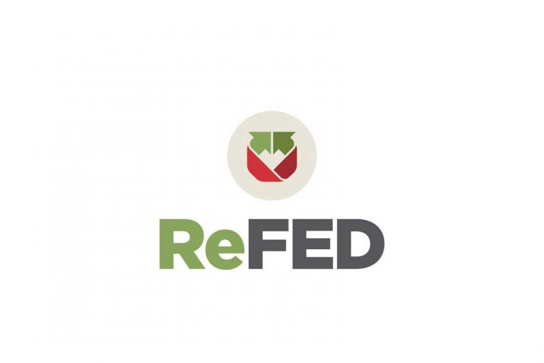



Sponsors and partners
Now:
Food Recovery Network (FRN)
Grinnell Farmers Market
Local Foods Connection (LFC)
Student Government Association (SGA)
Future:
Unilever
Procter & Gamble
ReFED
Forgotten Harvest
Notes:
Our current immediate partners consists of FRN, GFM, LFC, and SGA. We later plan on getting sponsors and partners from companies and organizations such as Unilever, proctor&gamble, reFED, and forgotten harvest

Slide 27
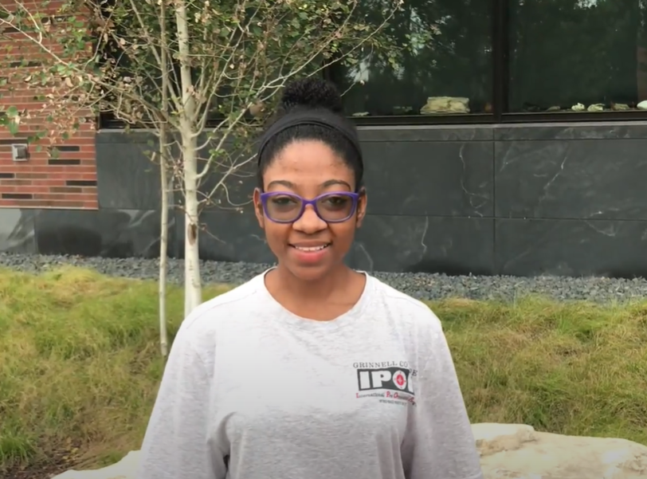
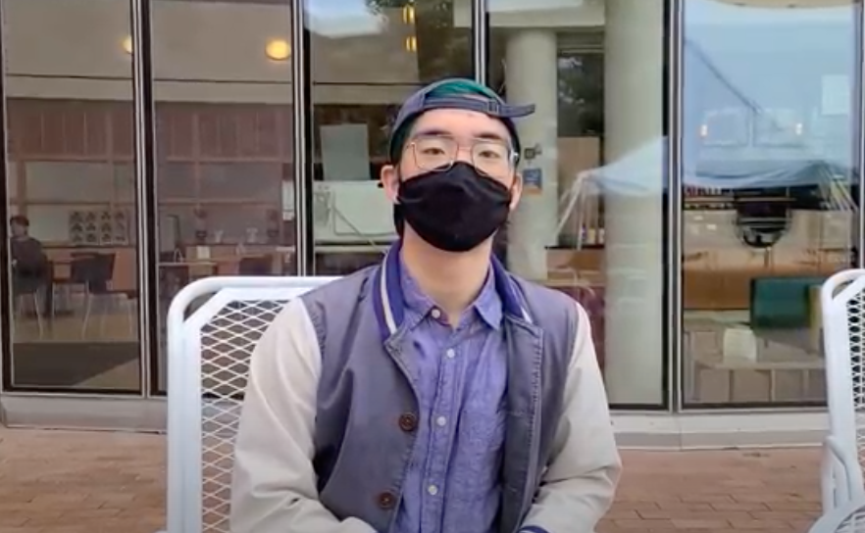
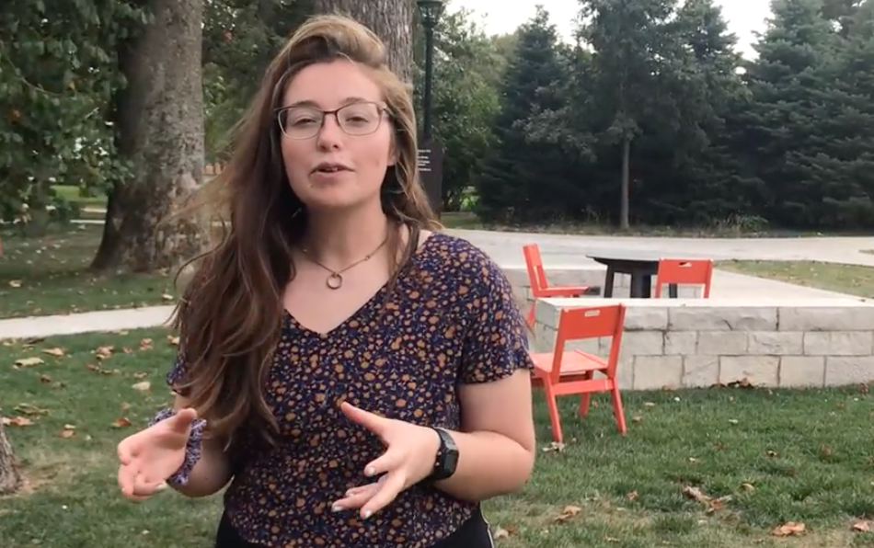
Thoughts from campus partners : Grinnell DHall Student Leader, Food Recovery Network, and Local Foods Connection
“We often throw out soups at the end of the day because we cannot store them.”
“...I think an app that tracks student food use ahead of time would be great in reducing food wastage.”
“Even though it is not always visible, a lot of people in Grinnell are food insecure.”

Slide 28
Year 1
Create app
Pilot and roll out in Grinnell College
Year 3
Enhance app features
Start a 501(c)(3)
Reach out to companies and investors to support our foundation
Implement in other regional colleges
Year 5
Implement nationwide
Partner with other companies
Saving 150,000 lbs of food
Saving 1,500,000 lbs of food
Saving 15,000,000 lbs of food

Slide 29
Food Savr
uniting to fight hunger
Uniting to fight hunger

